Slide 1

FoodiePal
surge pricing

Slide 2
Problem
Order processing
Daily/weekly/monthly peaks
Priority deliveries

Slide 3
Solution
Order processing platform
Surge pricing
Time slots

Slide 4
Demo

Slide 5


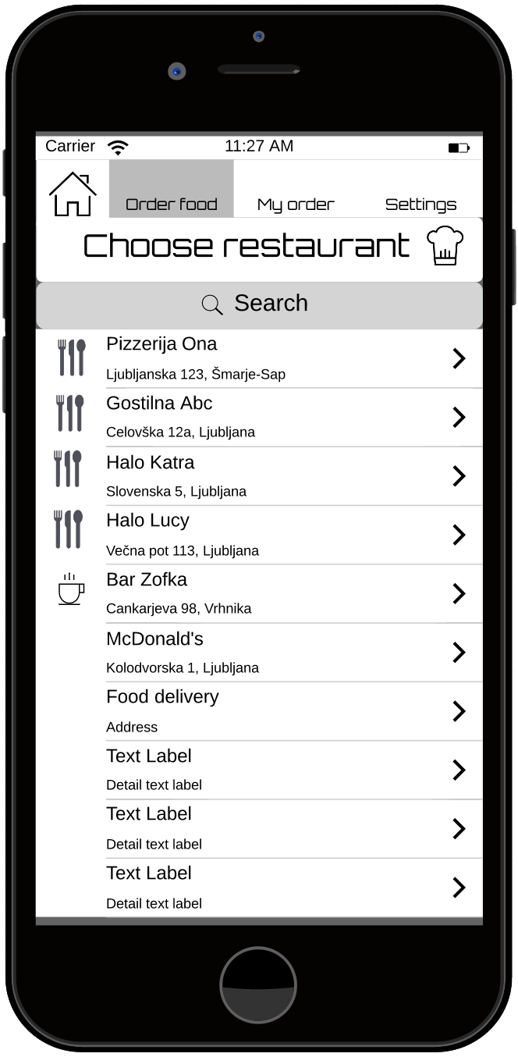
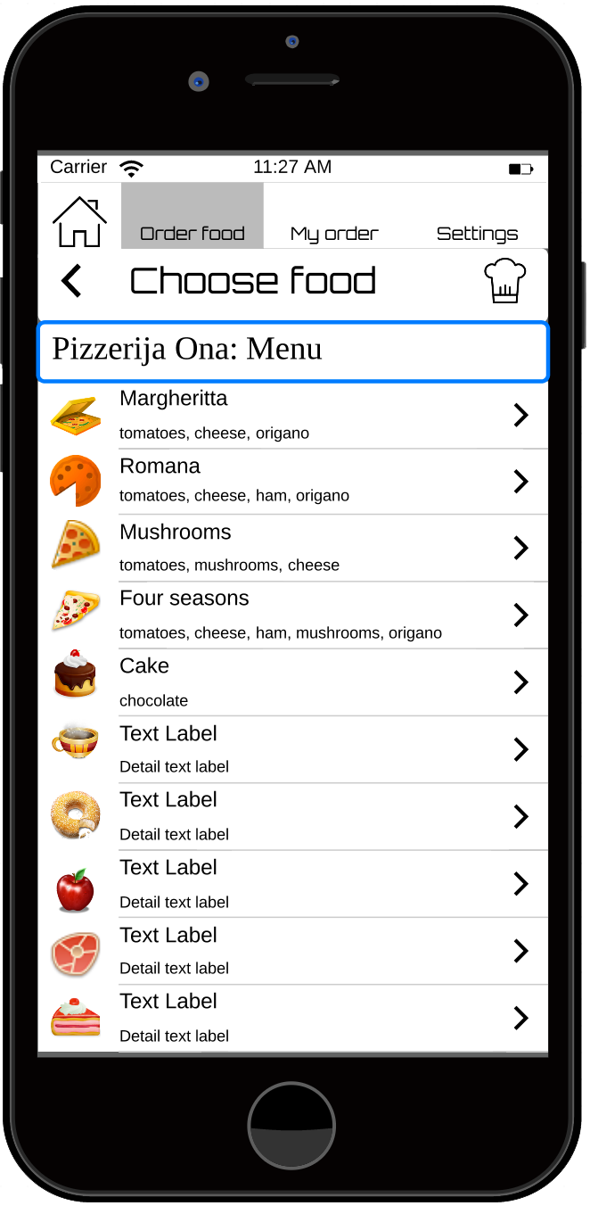
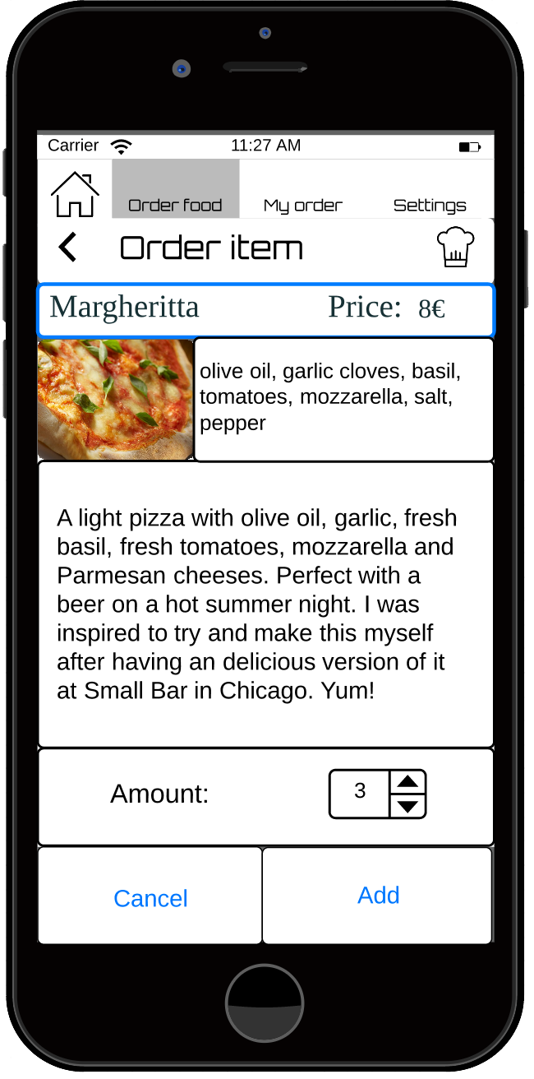
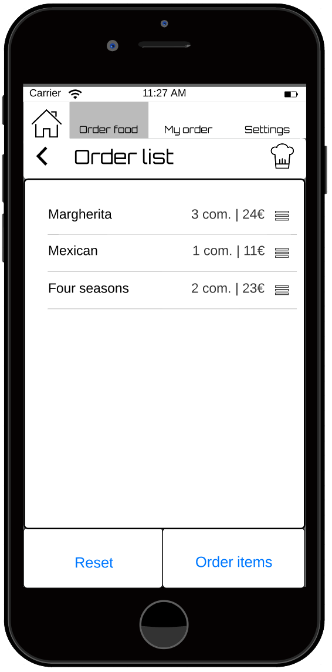
“I am hungry!”
Timmy
1
2
3
4
http://www.pd4pic.com/man-person-boy-cartoon-mouth-male-figure-avatar.html

Slide 6
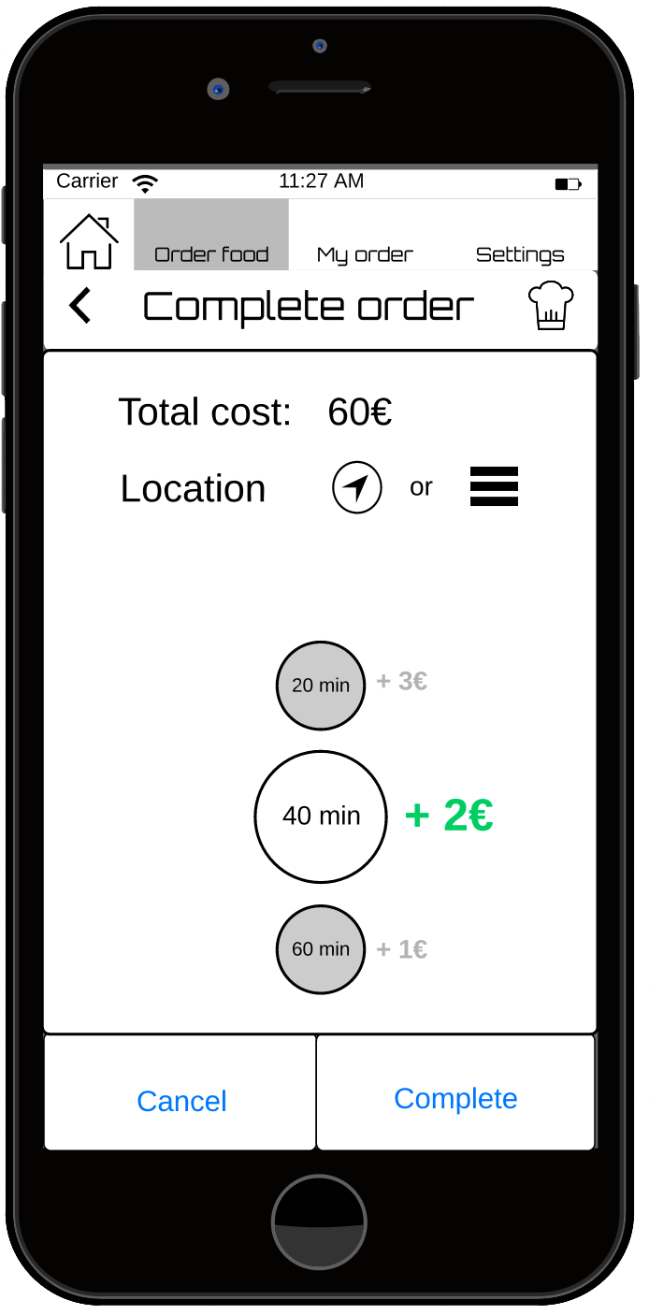
5

Slide 7
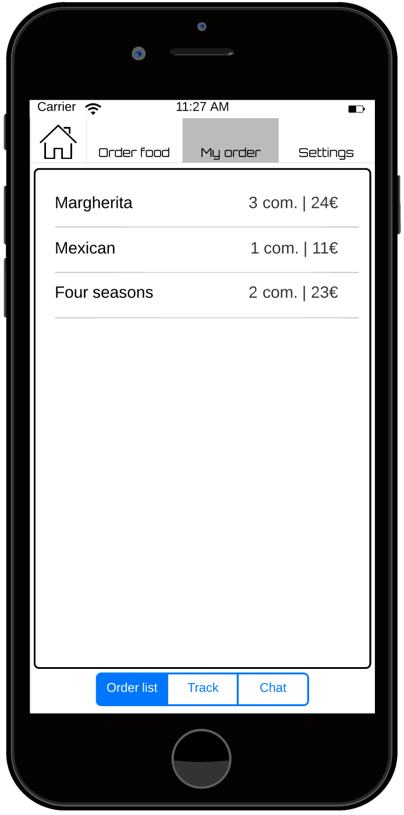
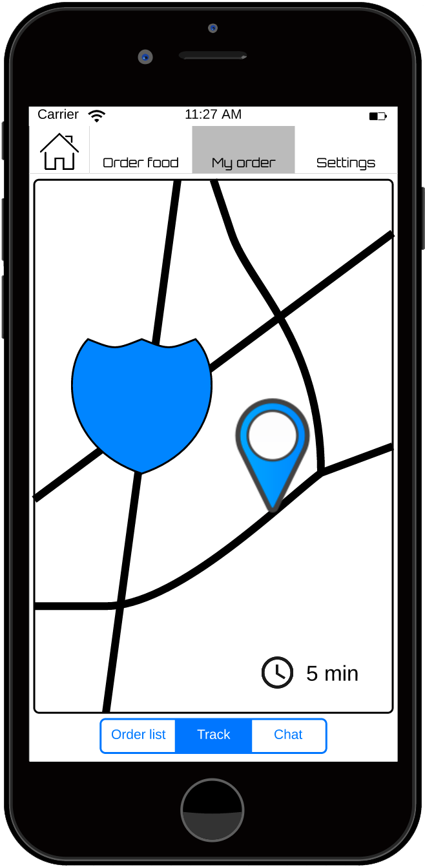
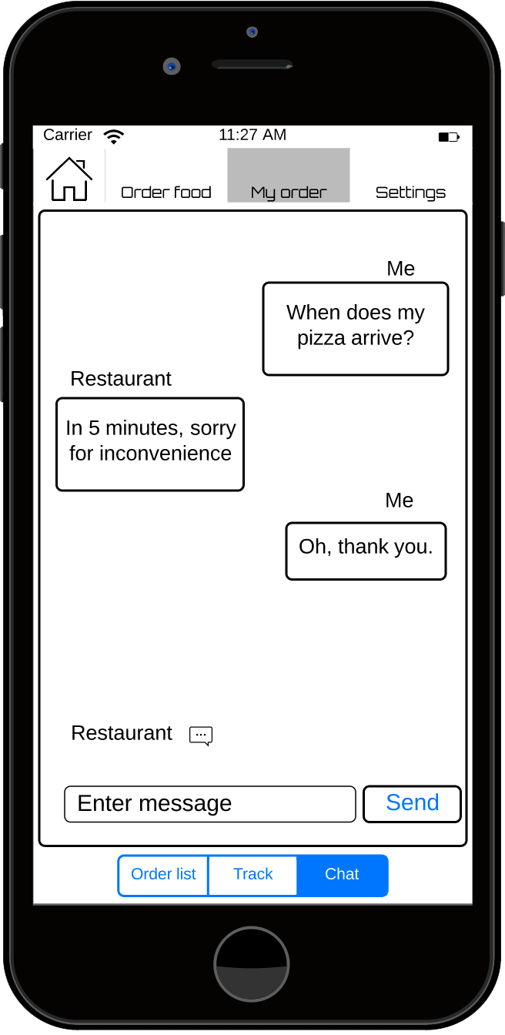
6
7
8

Slide 8
Market
Source: statista.com

Slide 9
Market
635.5k restaurants in US
≈ 14% are food deliveries
Target market
TAM
≈ 88k
Spring 2014

Slide 10


Competition
GrubHub
Seamless
MenuDrive

Slide 11
Monetization
5% of every transaction's regular price

Slide 12
Future plans
conquer U.S. market
app for all mobile platforms
plugin for existing POS software

Slide 13
We need
Time for development
More knowledge and experiences
Designer

Slide 14
Team
Aleksander Tomič - CEO
Žiga Černigoj - CTO
Matic Tkalec - CMO
? - Design

Slide 15
Thank you!
foodiepal.startup@gmail.com

Slide 16
Appendices

Slide 17
Monetization overview
Monetization:
5% of every transaction's regular price. If surge pricing was used while ordering, we subtract the price of fast delivery(surge + delivery price) and take 5% from the regular price.
We decided on this because:
it can bring a lot of money
the percentage can be increased or decreased, based on the restaurant's income
the surge pricing income to the restaurant is usually bigger than our 5% fee, their revenue increases
Competition:
GrubHub and Seamless take 13,5% of every order price on average. That is a lot compared to our 5% fee, and with us, the restaurant has an option of earning more with the surge pricing.
http://www.eater.com/2014/3/3/6270739/grubhub-charges-restaurants-an-average-13-5-commission-per-order

Slide 18
Monetization overview
Example.
Assumptions:
all orders are processed via FoodiePal
average restaurant has ≈ 30 food deliveries per day
average order is 20 EUR
40% of orders uses surge pricing: (12 orders)
17% orders per day(5 orders) … 20min [3EUR]
13% orders per day(4 orders) … 40min [2EUR]
10% orders per day(3 orders) … 60min [1EUR]
For restaurants
fee for our service = 0.05*20EUR*30 = 30 EUR (per day)
profit from surge pricing = 5*3EUR + 4*2EUR + 3*1EUR = 26EUR -> spent only ≈ 4 EUR per day instead of 30EUR (if there is no surge pricing and fee only 5%)

Slide 19
Cashflow
description |  | y1
 | subdesc. | Q1 | Q2 | Q3 | Q4
from operation |  | -12.550 | -7.250 | -6.700 | 14.500
 | salary for 3 | -9000 | -9000 | -13.500 | -13.500
 | workspace rent | -600 | -600 | -600 | -600
 | IT expences | -250 | -350 | -600 | -900
 | sales | 0 | 5.400 | 18.900 | 40.500
 | marketing | 0 | 0 | -4000 | -2000
 | designer | -2700 | -2700 | -2700 | -2700
 | extra programmers | 0 | 0 | -4200 | -6300
from financing
from investments |  | 30.000 | 0 | 0 | 0
 | seed | 30.000 | 0 | 0 | 0
NET(O) per q's |  | 17.450 | -7.250 | -6.700 | 14.500
Total in Budget |  | 17.450 | 10.200 | 3.500 | 18.000
all number represent EUR
minimum seed is 26.500 for positive balance

Slide 20
Cashflow overview
Average values
Avg. # of deliveries per day: 30
Avg. price of delivery: 20€
We get 5% of every delivery’s original price, even during peaks, when price is higher
Avg. from 1 delivery: 20€*0,05 = 1€
Our income per day and month
Per day: (30 deliveries)*(1€) = 30€
Per month: (30 days)*(30€) = 900€
From one customer in a quarter: 3(months)*(900€) = 2700€
Rentals
Office rent: 200€ per month, 600€ per quarter

Slide 21
Cashflow overview
Our income per quarters
Q2: we get 3 new customers (we start sales in 5th month)
900*(2 months)*3 = 5.400
Q3: we get 4 new customers, 7 total
2.700*7 = 18.900
Q4, we get 8 new customers, 15 total
2.700*15 = 40500
Salaries
Cofounders: 1000€ per month (Q1, Q2) 1500 € per month (Q3, Q4)
Designer: 900€ per month, 2700€ per quarter
Extra programmers: 700€ per month, 2100€ per quarter

Slide 22
Cashflow overview
Our IT expenses will be
One-time distribution fee for AppStore in Q1
Monthly subscription to Adobe CreativeCloud tools
Monthly fee for cloud service usage, starting with end of month 4, when our product will be released
We need designer
We won’t have time (and relevant skills) to design quality user interfaces
So we will need to hire designer at the start of development

Slide 23
Cashflow overview
We will need extra programmers
For easier and faster development, we will hire
Two programmers in Q3
One additional programmer in Q4
In case of investment, we will use money for:
Better infrastructure and plan execution
Better cloud service or our own cloud
Salaries, extra personnel

Slide 24
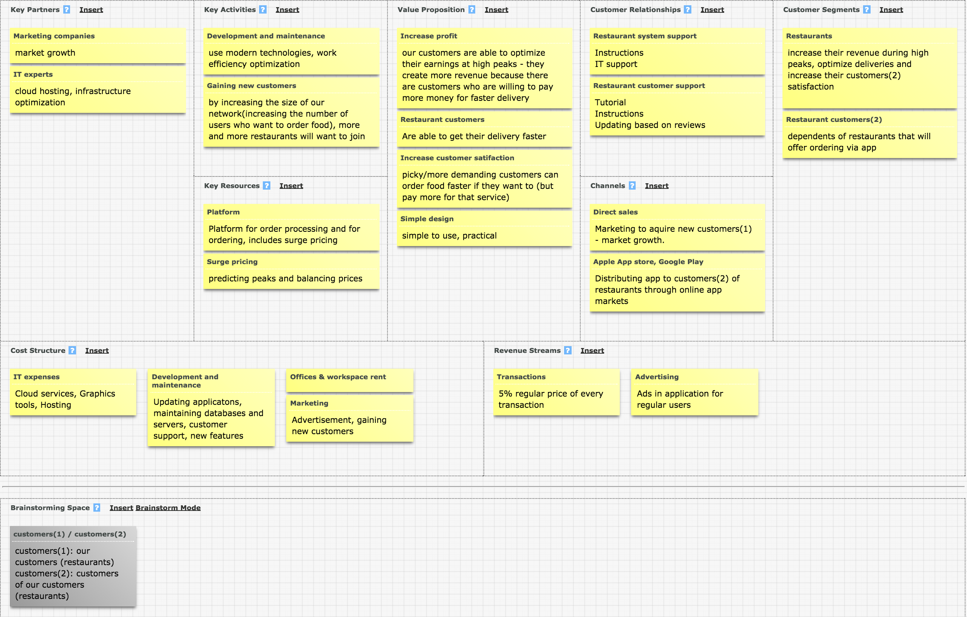
Business Model Canvas

Slide 25
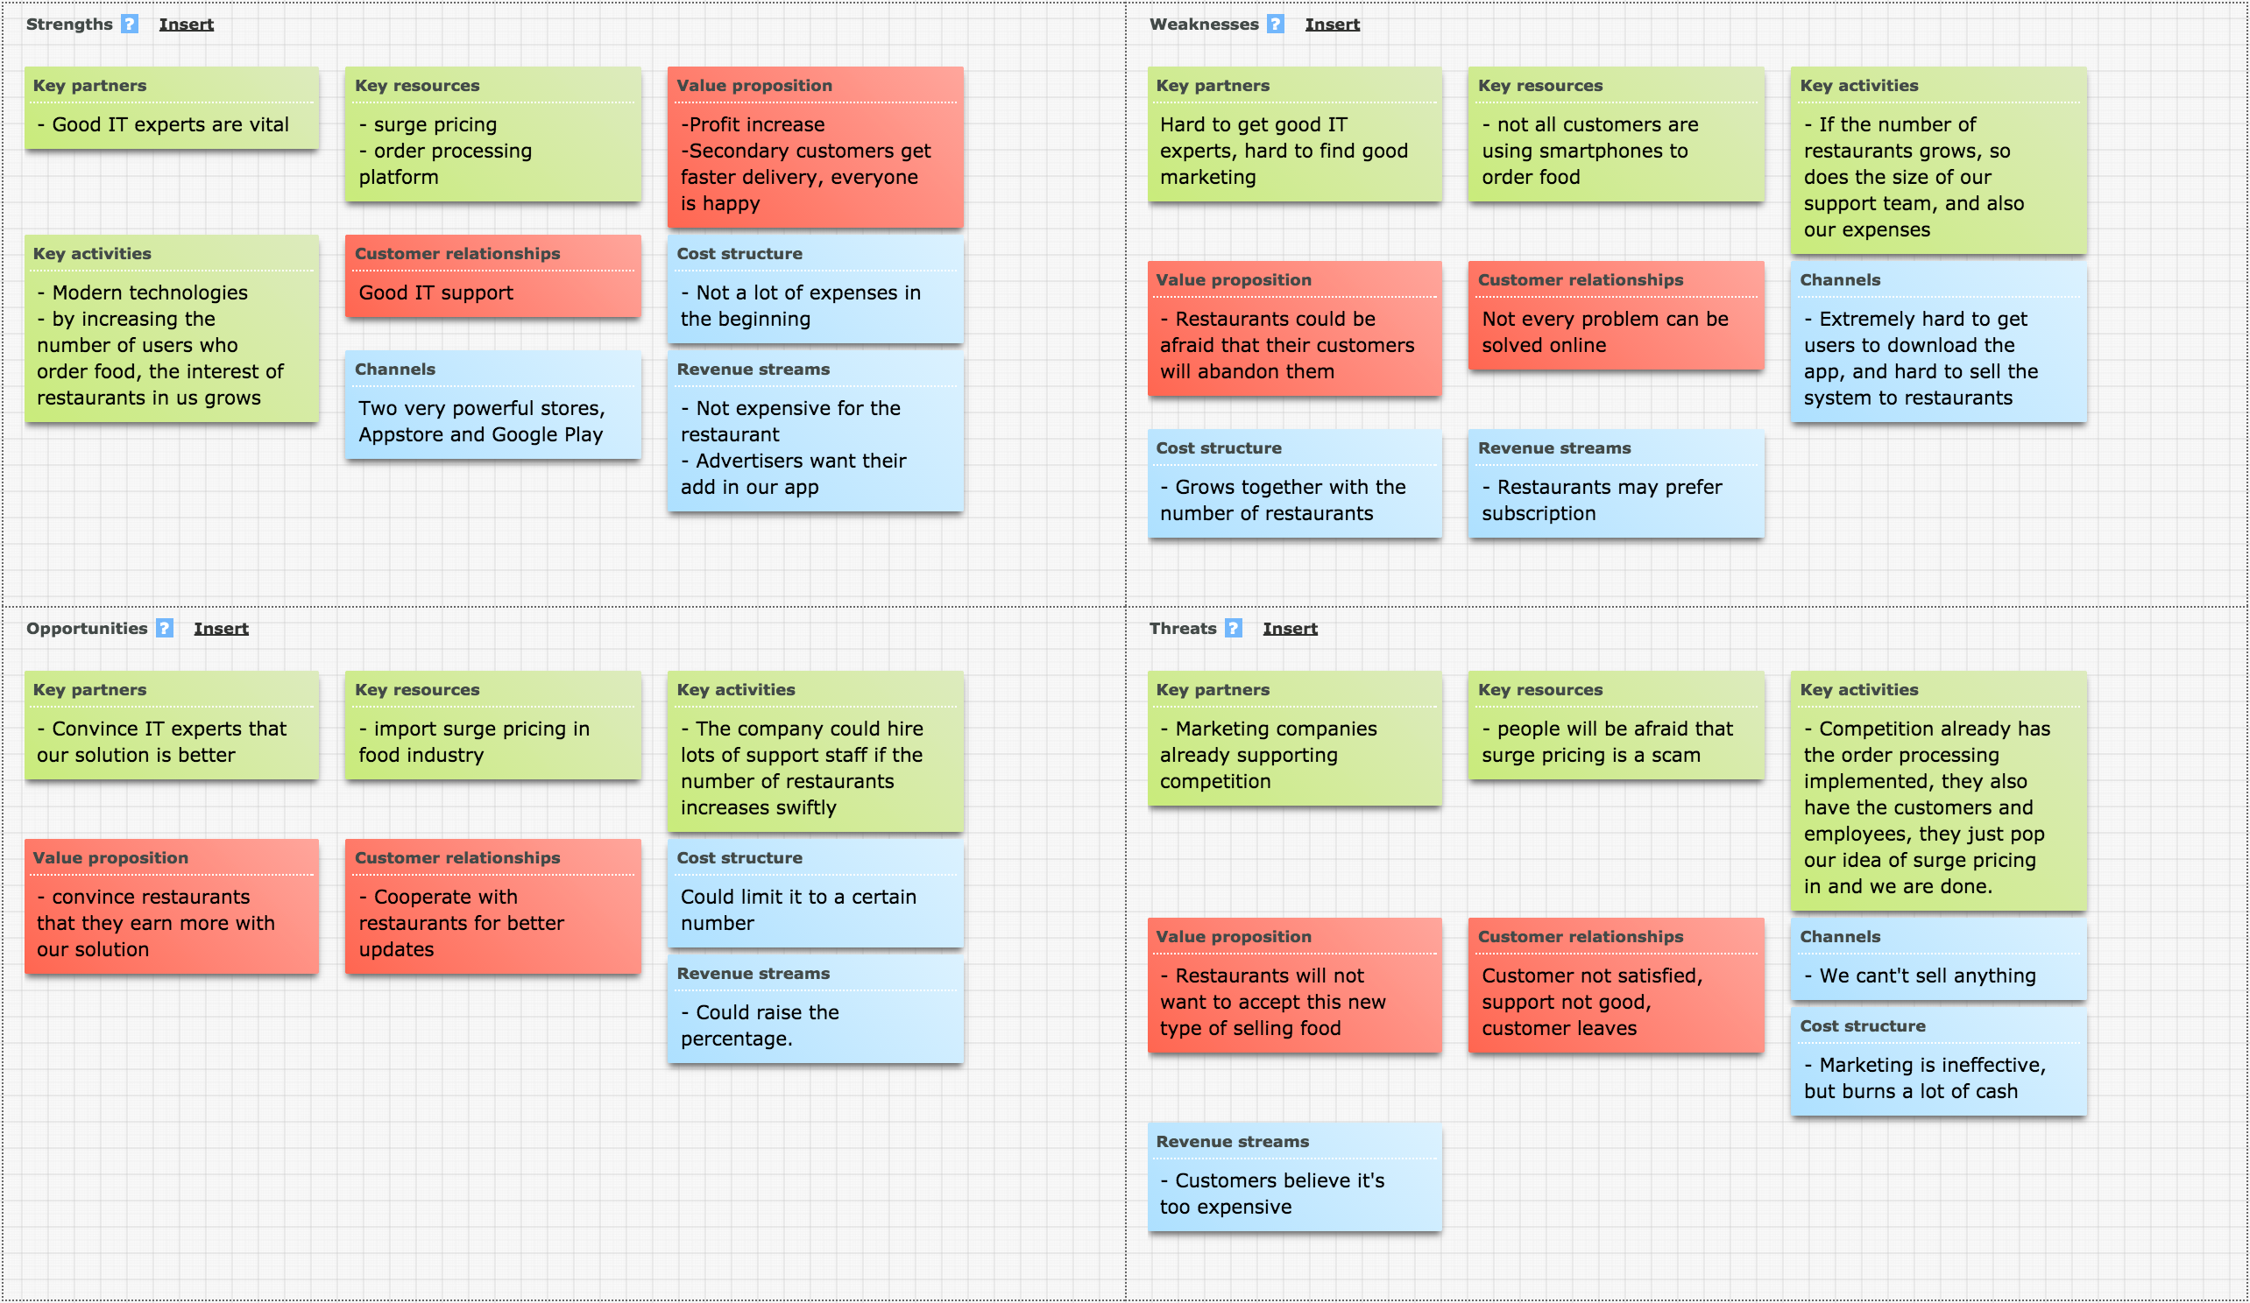
SWOT analysis

Slide 26
Value chain
Primary | product management | tech (sw) dev. | distribution(1) | design | support
 | planning, realization | app development, iterations, improvements | platform delivery to our customers(1) | dedicated design for our app | user support
Secondary | distribution (2) | marketing
 | app delivery for customers(2) through Google Play in Apple App Store | marketing
customers(1) : restaurants
customers(2) : restaurant customers

Slide 27
Competition analysis
attributes | FoodiePal | GrubHub | Seamless | MenuDrive
distribution | Appstore, Google Play, WWW | Appstore, Google Play, WWW | Appstore, Google Play, WWW | Android, WWW
time evaluation of order delivery | yes | yes | yes | yes
customer feedback | yes | yes | yes | yes
delivery tracker | yes | yes | no | no
surge pricing | yes | no | no | no
priority ordering | yes | no | no | no

Slide 28
FAQs

Slide 29
Q: How to get first customers (restaurants) to use our product?

Slide 30
A:
(We will send an offer or/and call a lot of restaurants and introduce our idea to them)
Just a few restaurants will accept the offer. They will have to introduce the new way of ordering to their customers. And if the idea catches on, these customers will suggest other restaurant to start using it.

Slide 31
Q: How to manipulate prices of time-slots?

Slide 32
A:
Every restaurant decides for itself, how much would they like to charge for faster delivery. They also determine which and how many time slots should currently be available, based on their capability to deliver food in time for these time slots.

Slide 33
Q: What happens when the user wants to order food to be delivered in 30min but location of the user is, let's say 40 min away from the restaurant?

Slide 34
A:
After he completes the order, the restaurant reviews it. They can see the location of the user who ordered food.
The manager can either accept the order or deny it, and propose a new, more realistic time for delivery and also the fee. Then the user can either accept the proposed time, or cancel and start a new order.

Slide 35
Miscellaneous
http://pizza.com/fun-facts
http://www.statista.com/statistics/244616/number-of-qsr-fsr-chain-independent-restaurants-in-the-us/
http://www.quora.com/How-many-restaurants-in-U-S-offer-home-delivery

